Slide 1
PS 643 – An Introduction
Anupam Guha

Slide 2
Please read the brochure on PS 643 carefully

Slide 3
A short history of AI, Data, and Policy. PS 626, PS 643, and PS 644 What do you come in with, what do you leave the course with? How do we talk to each other? Attendance policy and class participation Exam, assignments, presentations, project Should you take it? Classroom expectations

Slide 4
AI History and Concepts
Anupam Guha

Slide 5
What is intelligence and why do you care?

Slide 6
The Essence and the Function
What we are not talking about: Consciousness
What are we talking about?
Reasoning
Learning
Solving
Perceiving
Generating
Narrow and General Intelligence

Slide 7
How does AI create value?
Languages
Vision
Planning
Logic
Robotics
Search and optimisation
Is AI creating value or are people?

Slide 8
Agents
Environment
Action
Goals
Knowledge
Observations
Not all agents continuously learn
Simple reflexive, model based, role based

Slide 9
What is Policy? Why AI Policy? History State Commodity Labour

Slide 10
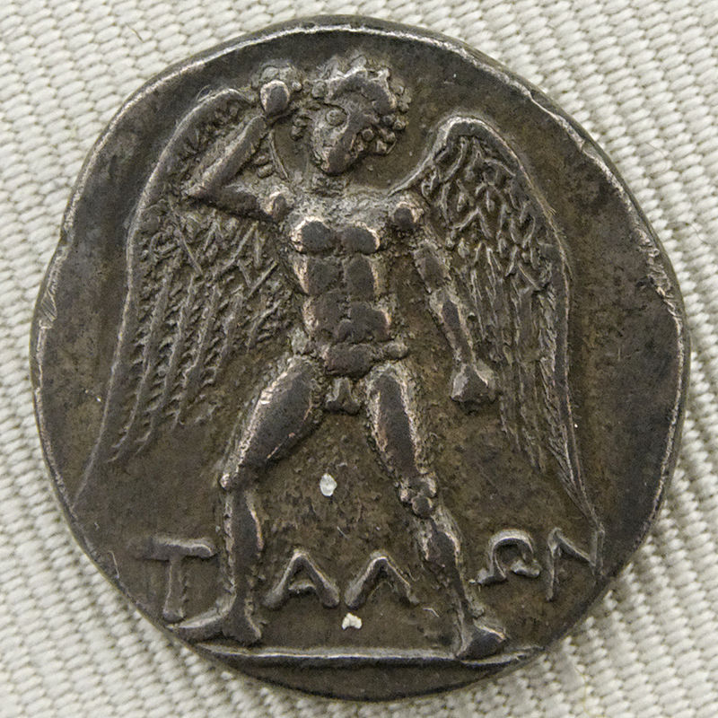
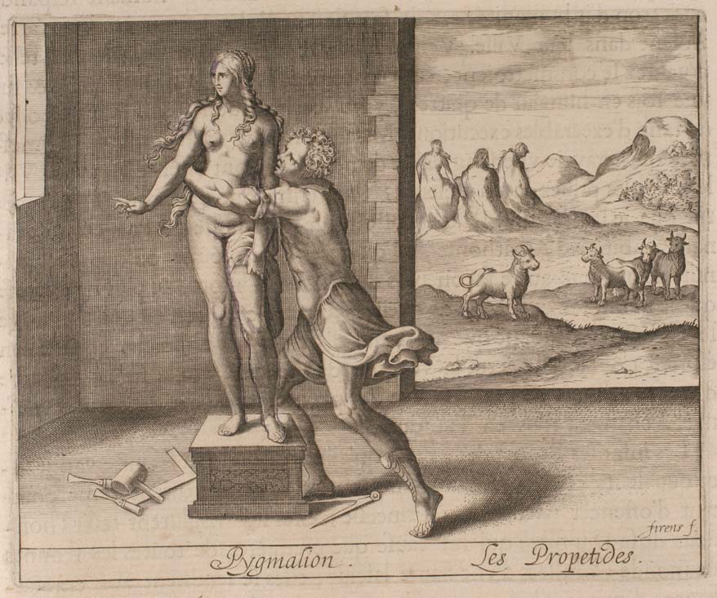
A Brief History of Artificial Intelligence

Slide 11
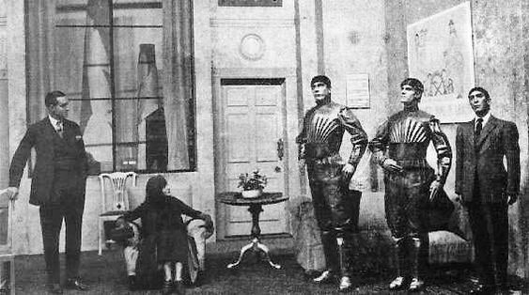
Imagination of AI

Slide 12
Samuel Butler’s Darwin Among the Machines

Slide 13
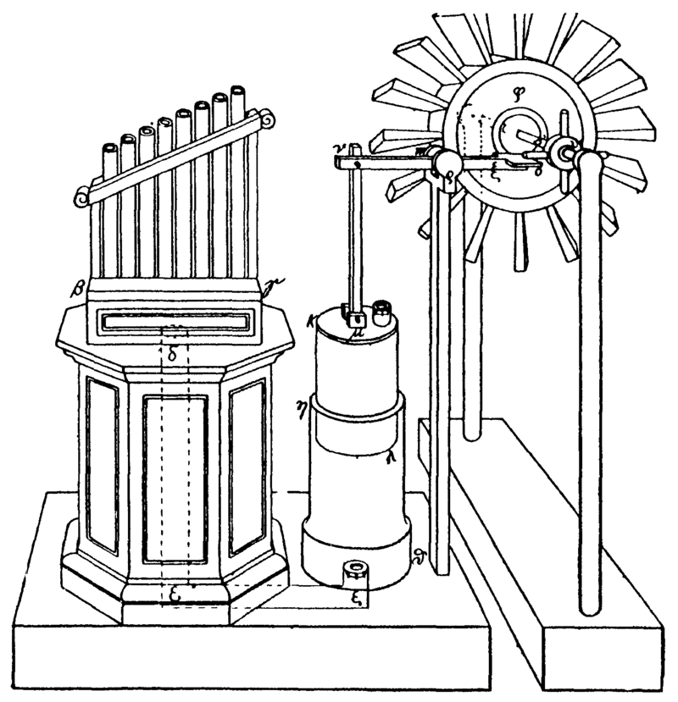
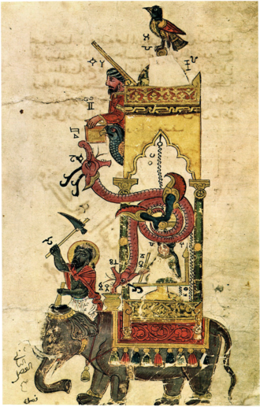
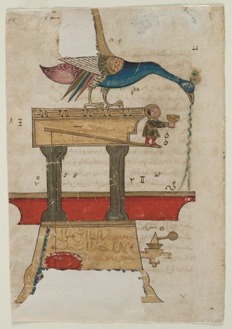
Historical Automata

Slide 14
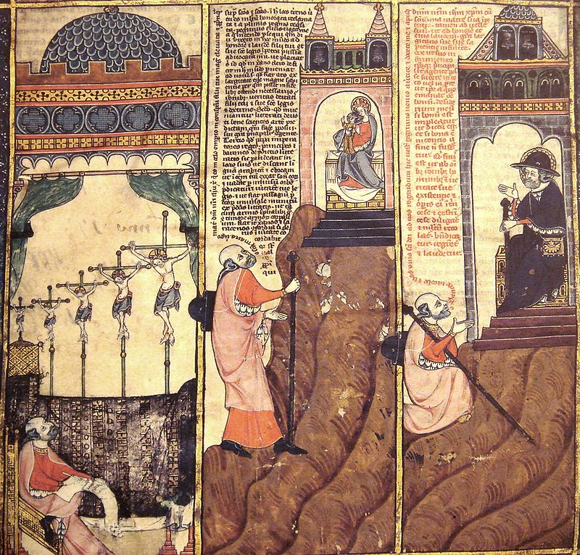
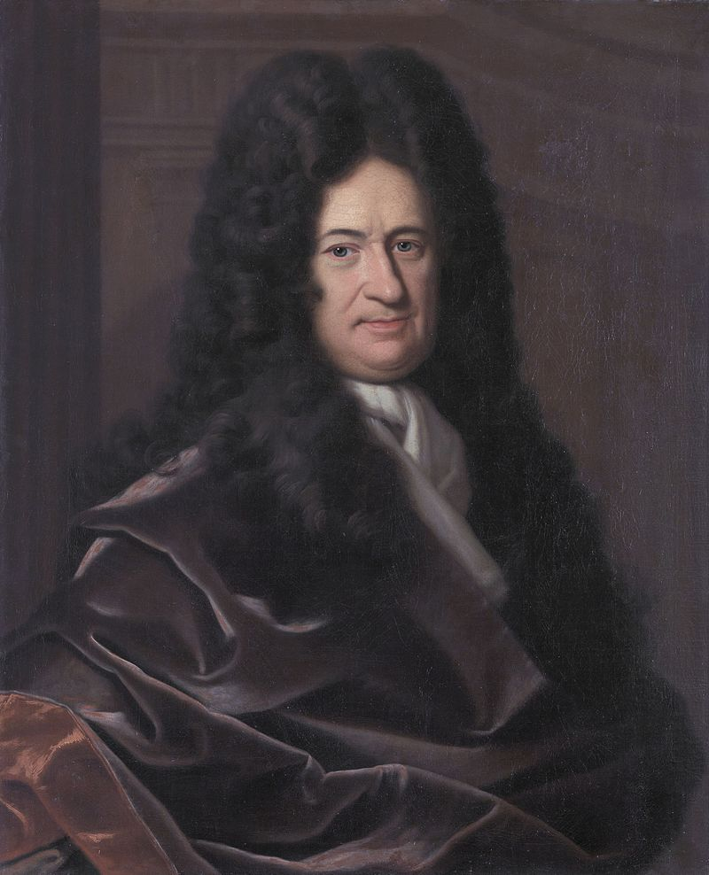
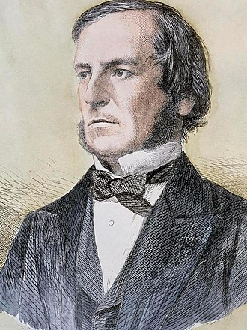
Formal Reasoning

Slide 15
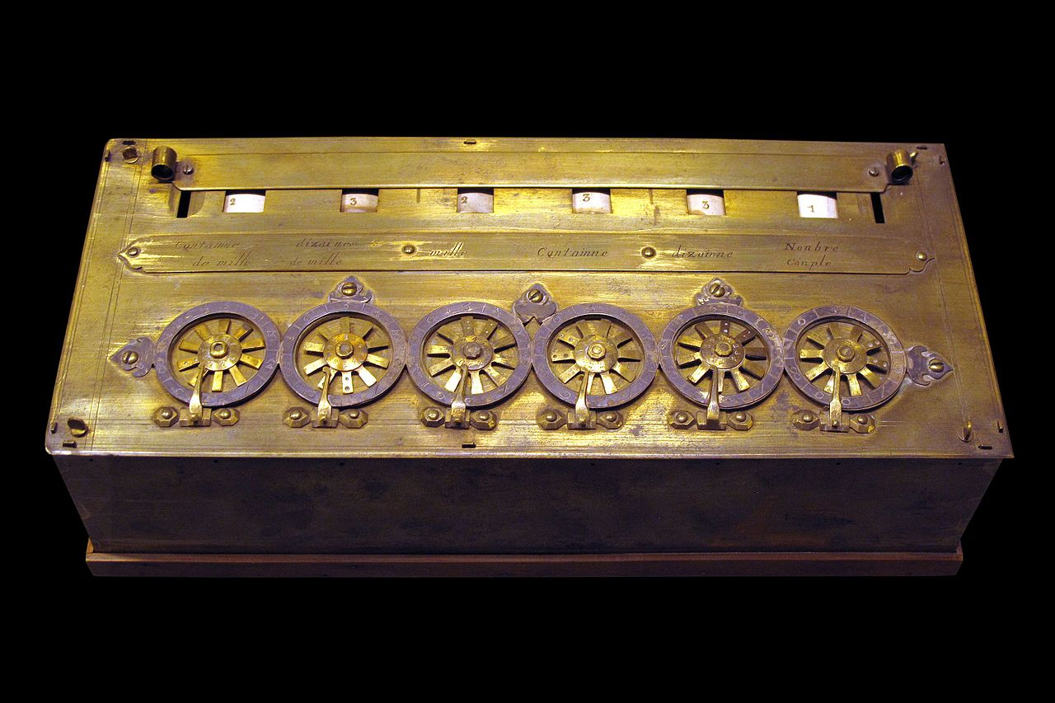
1642 AD, Pascaline the first calculator

Slide 16
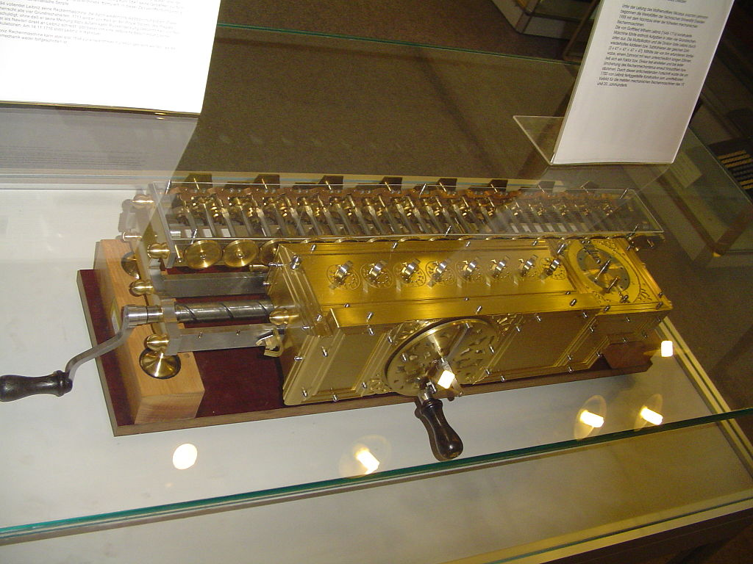
1672 AD, Leibnitz Stepped Reckoner

Slide 17
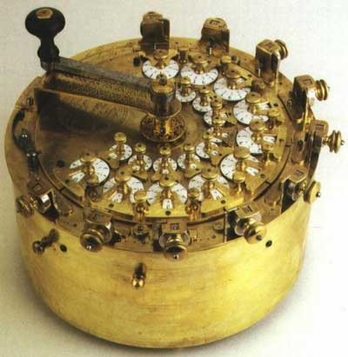
1774 AD, Philipp Matthäus Hahn

Slide 18
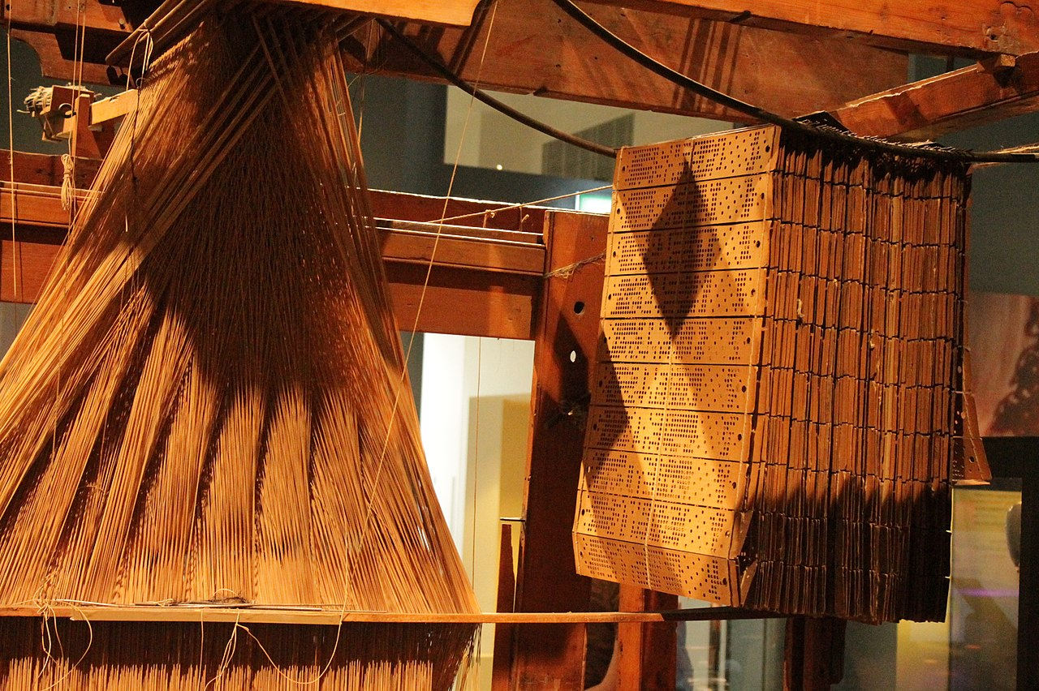
1804 AD, Joseph-Marie Jacquard

Slide 19
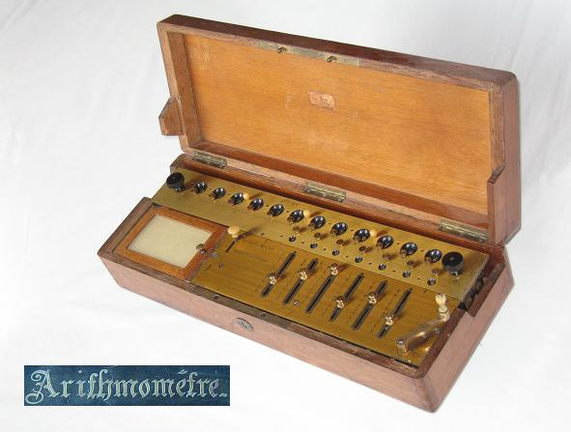
1820 AD, Charles Xavier Thomas de Colmar

Slide 20
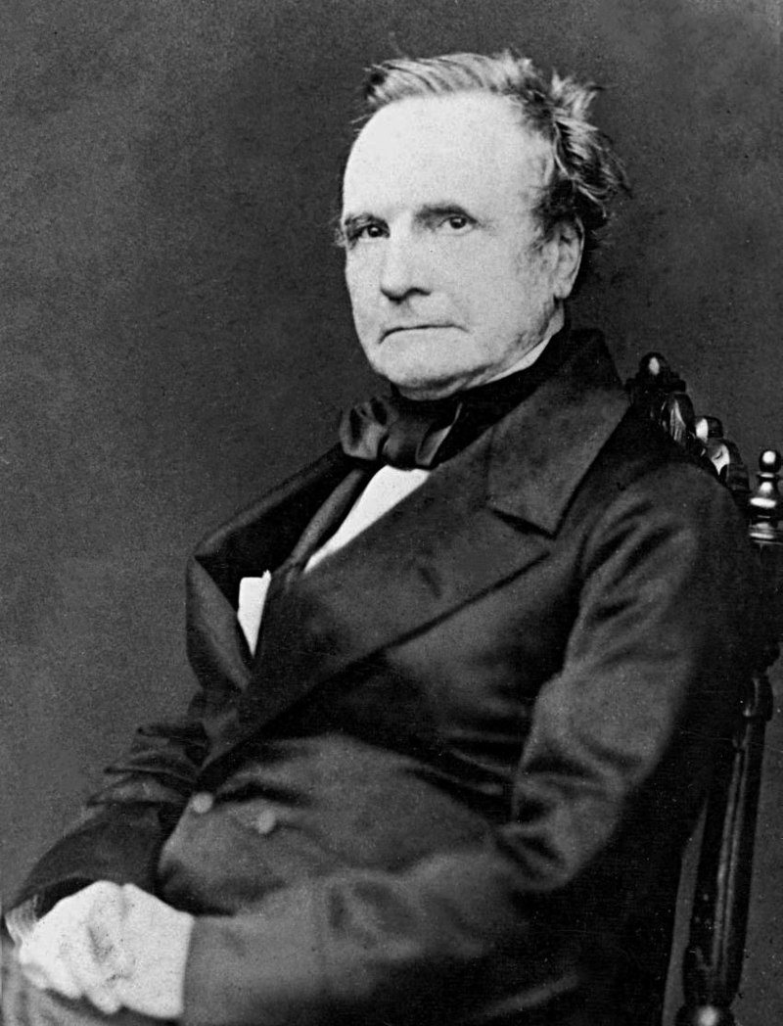
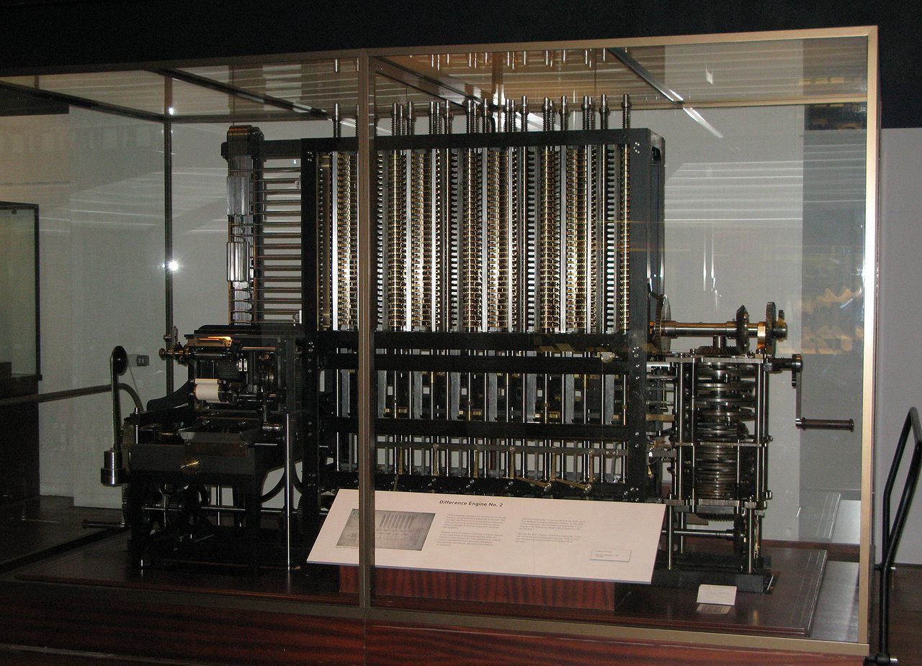
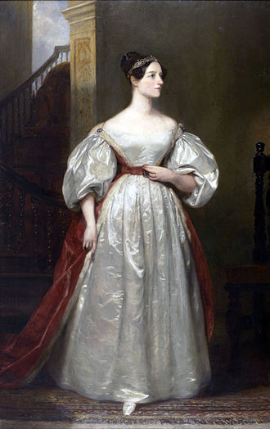
Computer Science

Slide 21
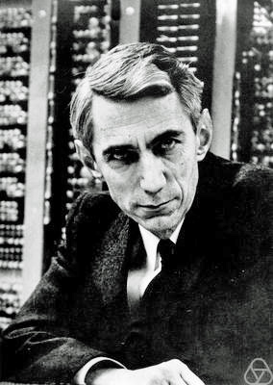
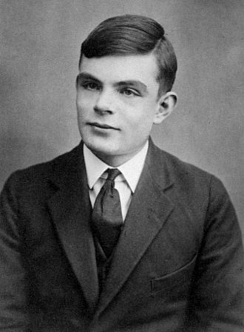
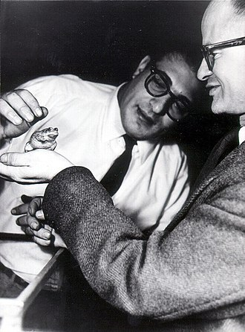
Cybernetics to Neural Networks

Slide 22
Modern History
1951 Ferranti Mark 1
1954 AI Boom
1956 Dartmouth Workshop
ELIZA
1974 First AI Winter
1980 Expert Systems Boom
1987 Bust
1993 – 2011 Victory of the Neats
Since 2011Deep Learning and Big Data

Slide 23
What is Machine Learning?
Algorithms that improve automatically through experience by using data
Data is unprocessed information
Information is data after processing
Training Data
Testing Data
Validation Data

Slide 24
Discussion www.anupamguha.com

